Slide 1


Mini-course
Computational Solid State Physics
Gerson J. Ferreira
Instituto de Física, Universidade Federal de Uberlândia
gersonjferreira@ufu.br
gjferreira.wordpress.com
Presented at
IFT / UNESP
XLIV Congresso Paulo Leal Ferreira de Física
October 25 – 27, 2021
www.infis.ufu.br

Slide 2
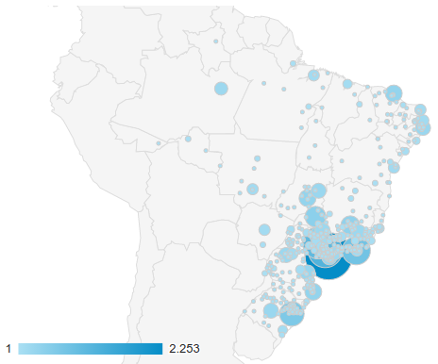

this portal is a pain...
Chrome/Firefox/Safari Extensions to bypass
CAPES/Portal de Periódicos (+15.000 users)
+ Bruno Messias de Resende
[IFSC/USP]
See also his doi2bib
https://pypi.org/project/doi2bib/
gjferreira.wordpress.com

Slide 3
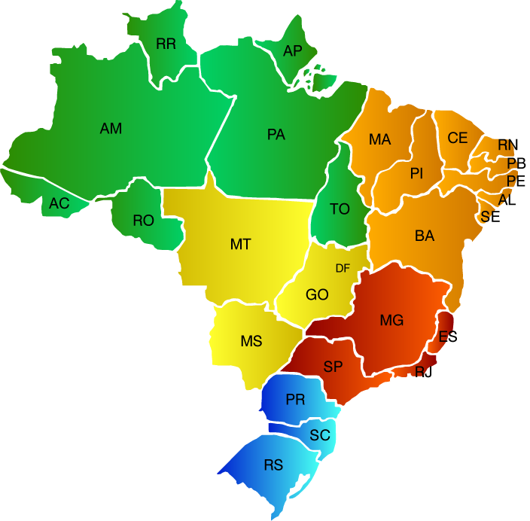
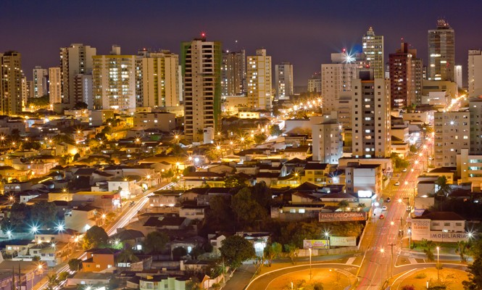

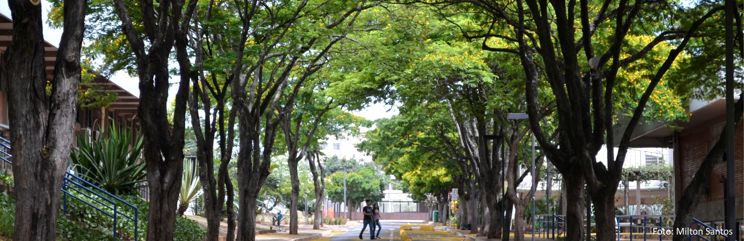
Uberlândia, MG
I’m here

Slide 4
Mini-course
Computational Solid State Physics
Outline
1) Introduction to python
→ Suggestion, use jupyter or Google colab: https://colab.research.google.com/
→ we’ll learn: the basics + numpy + matplotlib (arrays, linalg, fft, plots)
→ hands on tutorial
2) Schrödinger equation: numerical methods to find quantum well eigenstates
3) Topological insulators: the BHZ model
→ band structure and the topological phase transition
→ calculating the Berry curvature and the Chern number
→ the edge states

